Slide 1
UNIVERSAL HUMAN VALUES
MODULE 2

Slide 2
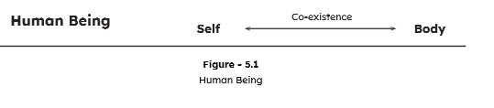
HUMAN BEING AS CO-EXISTENCE OF THE SELF AND THE BOBY
Human being is the co-existence of the self and the body.
When we say “ I ate delicious food”, we can see that the food was consumed by the body and I enjoyed the taste of the food”

Slide 3
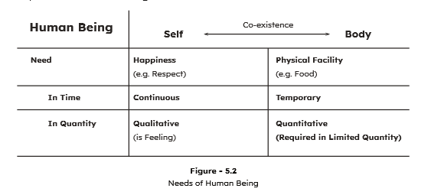
The needs of the self and the body

Slide 4
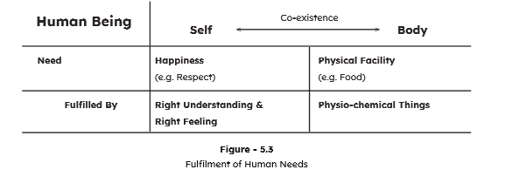
Fulfillment of the needs of the self and the body

Slide 5
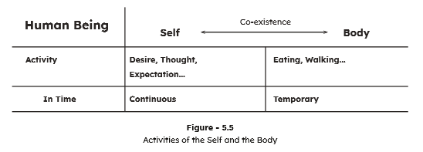
The activities of the self and the body

Slide 6
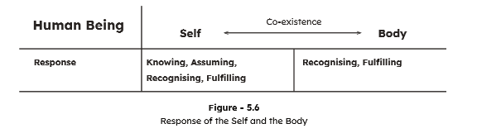
The response of the self and the body

Slide 7


Slide 11
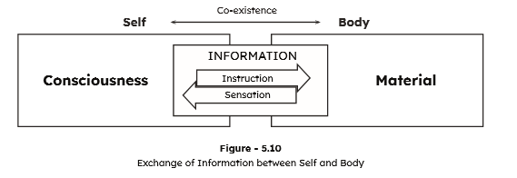
The self is central to the human being

Slide 12
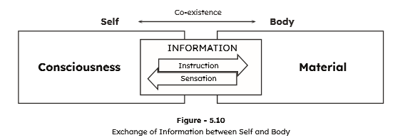
The body as an instrument of the self

